Slide 1
Inheritance
Mohammad Salman
Dean’s Fellow
https://www.learncpp.com/cpp-tutorial/introduction-to-inheritance/

Slide 2
Inheritance
These are your four main principles/pillars of object-oriented programming.
Encapsulation
Abstraction
Inheritance
Polymorphism
We will now see the third one, which is Inheritance.
Later on, we’ll talk about (runtime) polymorphism.

Slide 3
Inheritance
So far we have talked about the mechanics of OOP.
How objects are created?
How methods are called?
How memory is managed in the context of OOP?
Essentially, we’ve focused on the “how” of things?
We’ll now shift out attention back to the design process of an OO software/application.

Slide 4
Inheritance
It is here where you can actually exercise your “creative muscles” so to speak.
What classes need to be defined?
How will those classes interact with one another?
Usually, they do interact.
Your understanding of the problem you’re trying to simulate is crucial.
Classes are self-contained programs in their own right.
But in the context of an entire software, objects of various classes will interact with each other in order to make the application work.

Slide 5
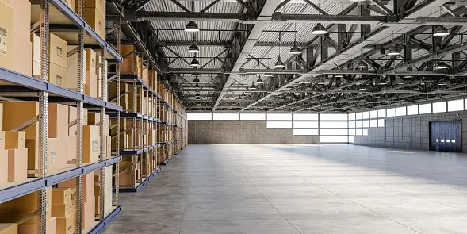
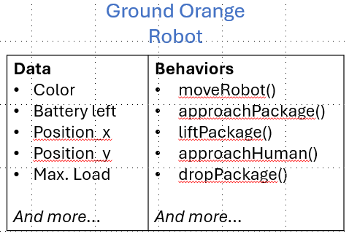

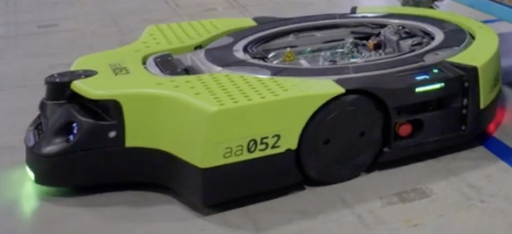


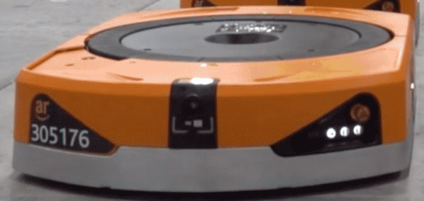
For example, recall our robots in a warehouse example.
Our class Robot was basically a composition of objects of other classes (along with some other built-in data types).
Composition is a “has-a” relationship.
A robot has-a position, has-a color, etc.

Slide 6
Let’s take a look at another relationship…
Based on our robots in a warehouse discussion, let’s say you also have drones in the warehouse.
And outside of supervisors, there will be other employees like the cleaning staff, cooking staff, engineers, etc.
You may also have different types of packaging.
Cartons
Envelope packets

Slide 7
Identifying Objects
White Drone
So these are all the objects that I should probably model.
Ground Green Robot
Ground Orange Robot
Warehouse
Carton
Supervisor
Envelope Packet
Engineer

Slide 8
We could then categorize them in classes.
Obviously, there can be more than one instance of each of these classes.
Note that the blue text represents objects.
Employee Category
Supervisor
Robot Category
Engineer
Ground Orange Robot
Building Category
Warehouse
Ground Green Robot
Package Category
Carton
White Drone
Envelope Packet

Slide 9
Employee Category
However, note that the objects in each class do appear to have similarities, but there also seem to be some differences.
A grounded robot and an aerial robot will have different attributes and/or methods.
Supervisor
Robot Category
Engineer
Ground Orange Robot
Building Category
Warehouse
Ground Green Robot
Package Category
Carton
White Drone
Envelope Packet

Slide 10
So you can categorize them in different classes. But here’s the problem.
The types of robots also have some class members that will be common (e.g. battery, motors, etc.).
If you create completely separate classes, parts of your class definitions will repeat.
What if I could make a common class that contained all of this information? Then I wouldn’t have to repeat.
Here comes in inheritance.
class GroundedRobot
{
// m_battery
// m_microcontroller
// m_cameraSensor
// m_wheels
};
class GroundedRobot
class AirRobot
class AirRobot
{
// m_battery
// m_microcontroller
// m_cameraSensor
// m_propellers
};
Ground Orange Robot
White Drone
Ground Green Robot

Slide 11
You have a parent class or a base class that contains the common data and behaviors.
The child class or the derived class can then extend the capabilities of the parent/base class.
In this example, the Robot class will have common members such as battery, microcontroller, camera sensor, etc. These will be possessed by the objects of all derived classes.
But the GroundRobot class can have wheels, whereas the AirRobot class can have propellers.
Therefore, the derived classes have somehow built on top of (or extended) the base class.
class Robot
Note
A derived class extends the capabilities of its base class.
class GroundedRobot
class AirRobot

Slide 12
So this is what inheritance will look like in code (without adding a lot of details).
Note that the derived classes are coupled to the base class.
Any changes made in the base class will be reflected on the derived classes.
// Common data and functions
class Robot
{
// m_battery
// m_microcontroller
// m_cameraSensor
};
class GroundedRobot : public Robot
{
// m_wheels
};
class AirRobot : public Robot
{
// m_propellers
};
class Robot
class GroundedRobot
class AirRobot
Notes:
Does this coupling also get created when you use composition instead of inheritance?

Slide 13
What we have here is a class hierarchy.
Observe that the classes at the bottom of the hierarchy are more specific or specialized.
And as you climb up the hierarchy, you will notice that the classes become more general (with lesser details).
More general / abstract
class Robot
Note
A derived class is typically more specialized than its base class.
class GroundedRobot
class AirRobot
Less general / abstract

Slide 14
You can create multiple levels of hierarchy depending on the problem that you’re trying to simulate.
More general / abstract
Note
You can have multiple levels of inheritance.
class Robot
class GroundedRobot
class AirRobot
class TrackedWheels
class RegularWheels
class VTOL
class CTOL
Less general / abstract

Slide 15
So the idea is that when designing, if you see objects/entities that are similar but not identical.
You could create a parent class that contains the common data and functions, and then…
… create derived classes which will inherit the parent’s members, and have the option to extend those capabilities.
More general / abstract
class Employee
Another example
class Supervisor
class Engineer
class CookingStaff
class CleaningStaff
Less general / abstract

Slide 16
Now that we’ve seen that inheritance helps us extend and re-use the functionalities of base classes, here’s an idea.
What about composition that we saw earlier?
What if I did this?
// Common data and functions
class Robot
{
// m_battery
// m_microcontroller
// m_cameraSensor
};
class GroundedRobot
{
// Robot m_common
// m_wheels
};
class AirRobot
{
// Robot m_common
// m_propellers
};
class Robot
class GroundedRobot
class AirRobot
Note that that arrowheads and their directions have changed.

Slide 17
Recall that composition creates a “has-a” relationship, which in this example doesn’t make sense.
A GroundedRobot object has-a Robot.
No no.
A GroundedRobot object is-a Robot (this is the relationship that inheritance creates).
// Common data and functions
class Robot
{
// m_battery
// m_microcontroller
// m_cameraSensor
};
class GroundedRobot
{
// Robot m_common
// m_wheels
};
class AirRobot
{
// Robot m_common
// m_propellers
};
class Robot
class GroundedRobot
class AirRobot
DerivedClass is-a BaseClass.
DerivedClass is-a-kind-of BaseClass.

Slide 18
